Slide 1
Where’s the Money? Federal Budget Updates
SPEAKERS
MODERATOR: Cathy Alderman, Vice President of Communications and Public Policy, Colorado Coalition for the Homeless
John Parvensky, CEO/President, Colorado Coalition for the Homeless
Diane Yentel, President/CEO, National Low Income Housing Coalition
Wendy Hawthorne, Deputy Director, Division of Housing, Colorado Dept of Local Affairs
Kathryn Grosscup, Senior Tax Credit Officer, Colorado Housing and Finance Authority
Hear from national and local leaders in the homelessness and housing advocacy arena on what federal dollars are available and how they flow to organizations, public housing authorities, and individuals. Learn about changes in funding streams over the years and how Colorado has been impacted.

Slide 2
Homelessness Funding
John Parvensky, President/CEO Colorado Coalition for the Homeless

Slide 3
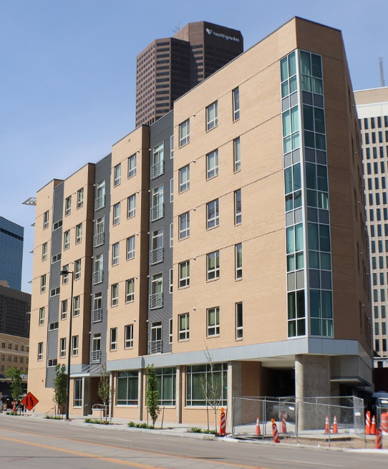
McKinney Vento Homeless Assistance Act
as Amended by the HEARTH Act
Continuum of Care Program
Transitional housing
Supportive services
Short- and medium-term rent subsidies
Permanent housing
Emergency Solutions Grant
Homelessness Prevention
Rapid Re-Housing

Slide 4
McKinney Vento History
Congress enacted
Stewart B. McKinney
Homeless Assistance Act
Act renamed
McKinneyVento Homeless
Assistance Act
2009 Congress passed HEARTH Act
Notes:
Congress enacted the Stewart B. McKinney Homeless Assistance Act in 1987.
In 2000, the act was renamed the McKinneyVento Homeless Assistance Act.
In 2009, Congress passed the HEARTH Act, which was intended to consolidate separate homelessness programs at HUD and to make the system of homeless assistance more performance-based.
HUD’s McKinney-Vento programs provide outreach, shelter, transitional housing, supportive services, short- and medium-term rent subsidies, and permanent housing for people experiencing homelessness, and in some cases for people at risk of homelessness.

Slide 5
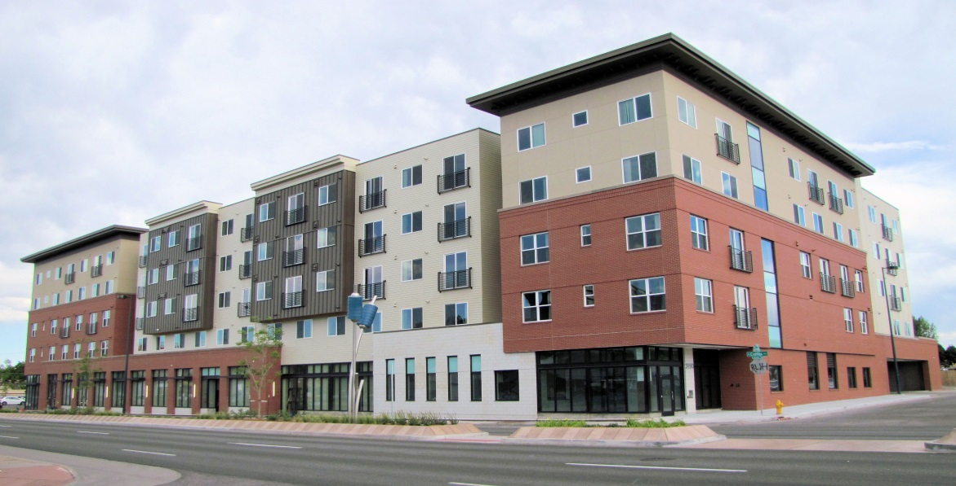
McKinney-Vento and HUD
Continuum of Care (CoC)
A consolidation of HUD's competitive grant programs
The creation of a Rural Housing Stability Assistance Program
A change in HUD's definition of homelessness and chronic homelessness
A simplified match requirement
An increase in prevention resources
An increase in emphasis on performance
Notes:
Continuum of Care (CoC)
The Supportive Housing program, which funded transitional housing, permanent supportive housing, and supportive services.
The Shelter Plus Care program, which funded rental assistance in permanent supportive housing for people experiencing homelessness with disabilities.
The Moderate Rehabilitation/Single Room Occupancy (SRO) program, which funded operating assistance in SRO buildings
Emergency Solutions Grants (ESG)
A formula grant to states and to larger cities and counties to fund rapid re-housing, homelessness prevention programs, and emergency shelters for people experiencing homelessness.
People are eligible for prevention or re-housing assistance if they are homeless or at risk of homelessness.
Being at risk of homelessness means an individual or family has income below 30% of area median income and are losing their housing, doubled up, living in motels, or living in other precarious housing situations.

Slide 6
McKinney-Vento and HEARTH
Consolidated into one CoC Program
Permanent Supportive Housing
Rapid Re-Housing
Transitional Housing
Supportive Services Only
HMIS
Planning Grants
Continuum of Care (CoC)
Supportive Housing
Shelter Plus Care
Moderate Rehabilitation/Single Room Occupancy (SRO)
Notes:
Continuum of Care (CoC)
The Supportive Housing program, which funded transitional housing, permanent supportive housing, and supportive services.
The Shelter Plus Care program, which funded rental assistance in permanent supportive housing for people experiencing homelessness with disabilities.
The Moderate Rehabilitation/Single Room Occupancy (SRO) program, which funded operating assistance in SRO buildings
Emergency Solutions Grants (ESG)
A formula grant to states and to larger cities and counties to fund rapid re-housing, homelessness prevention programs, and emergency shelters for people experiencing homelessness.
People are eligible for prevention or re-housing assistance if they are homeless or at risk of homelessness.
Being at risk of homelessness means an individual or family has income below 30% of area median income and are losing their housing, doubled up, living in motels, or living in other precarious housing situations.

Slide 7
McKinney-Vento and HUD
Emergency Solutions Grants (ESG)
Rapid re-housing
Homelessness prevention programs
Emergency shelters
Provided to States and Larger Cities
Notes:
Continuum of Care (CoC)
The Supportive Housing program, which funded transitional housing, permanent supportive housing, and supportive services.
The Shelter Plus Care program, which funded rental assistance in permanent supportive housing for people experiencing homelessness with disabilities.
The Moderate Rehabilitation/Single Room Occupancy (SRO) program, which funded operating assistance in SRO buildings
Emergency Solutions Grants (ESG)
A formula grant to states and to larger cities and counties to fund rapid re-housing, homelessness prevention programs, and emergency shelters for people experiencing homelessness.
People are eligible for prevention or re-housing assistance if they are homeless or at risk of homelessness.
Being at risk of homelessness means an individual or family has income below 30% of area median income and are losing their housing, doubled up, living in motels, or living in other precarious housing situations.

Slide 8
Funding vs Homelessness
Funding Levels
Point-In-Time Homelessness Numbers
FY 2011 & FY 2012 – $1.901 billion
FY 2013 – $1.933 billion
FY 2014 – $2.105 billion
FY 2015 – $2.135 billion
FY 2016 – $2.25 billion
FY 2017 – $2.383 billion
FY 2018 – $2.513 billion
FY 2019 – $2.636 billion
2011 – 623,788
2012 – 621,533
2013 – 590,364
2014 – 576,450
2015 – 564,708
2016 – 549,928
2017 – 550,996
2018 – 552,830
2019 – No numbers yet
Notes:
* Funding Levels FY13 After Sequestration
Challenges with PIT #s (significant undercount because of definition and difficulty administering)

Slide 9
Funding for Colorado
New
Projects
Continuum of Care
Metro Denver Homeless Initiative
Balance of State
Colorado Springs
TOTAL
$ 27,165,633 $ 354,041
$ 3,082,384 $ 0
$ 2,407,701 $ 0
$ 32,685,718 $ 354,041
Notes:
What Colorado Receives (2018)

Slide 10
Funding for Colorado
Emergency Solutions Grants
State of Colorado $ 1,965,723
Denver $ 569,662
Aurora $ 241,052
Colorado Springs $ 243,746
TOTAL $ 3,020,183
Notes:
What Colorado Receives (2018)

Slide 11
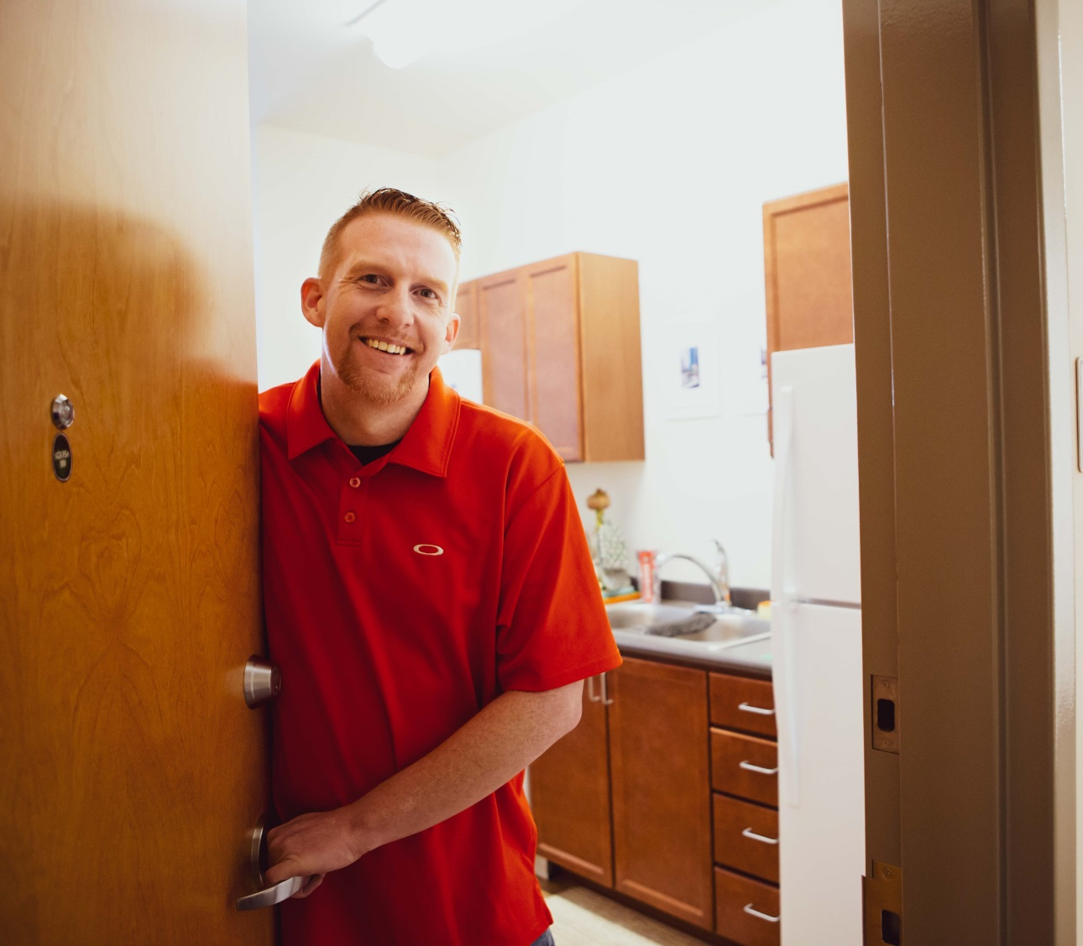
Affordable Housing Assistance Funds
Tenant-Based Rental Assistance
Project-Based Rental Assistance
HOME
Low Income Housing Tax Credits
Notes:
There are also four program accounts in appropriations bills that represent almost all Federal spending for affordable housing assistance for people with the lowest incomes:
Tenant-Based Rental Assistance (TBRA) — this includes the Housing Choice Voucher (HCV) program (“Section 8”), Housing and Urban Development-Veterans Affairs Supportive Housing (HUD-VASH) vouchers, and Family Unification Program (FUP) vouchers
Project-Based Rental Assistance (PBRA) — formerly known as “Project-Based Section 8,” this program provides rent subsidies for many privately owned affordable housing programs
Public Housing accounts:
Operating Funds — used by Public Housing Authorities for day-to-day costs
Capital Grants — used for larger scale building repairs or maintenance

Slide 12
HOME and Community Development Block Grant
The HOME Investment Partnerships Program (HOME)
Direct rental assistance
Funds building, buying, and rehabilitating affordable housing
Community Development Block Grant (CDBG)
Resources to address a wide range of community development needs
Notes:
The HOME Investment Partnerships Program (HOME) provides formula grants to states and localities to provide direct rental assistance and fund building, buying, and rehabilitating affordable housing for rent or homeownership.
Colorado received approximately $34 million in HOME funding in 2017.
The Community Development Block Grant (CDBG) program provides communities with resources to address a wide range of community development needs.
Colorado received approximately $13 million in CDBG funding in 2017.

Slide 13
Shrinking Federal Grants

Slide 14
Housing Funding vs the Need

Slide 16
Diane Yentel, National Low Income Housing Coalition
Low Income Housing Tax Credit
National Housing Trust Fund
Federal Budget Update
Federal Legislation re: Housing
Housing as Part of the 2020 Election

Slide 17
Where’s the Money?
Wendy Hawthorne
Deputy Director
Division of Housing

Slide 18
DOH Mission
The Division of Housing partners with local communities to create housing opportunities for Coloradans who face the greatest challenges to accessing affordable, safe and secure homes.

Slide 19
What have we done?
Funded over 700 PSH PBV units in the past 4 years
Serves over 33,000 households
Created 3,500 new affordable housing opportunities in the past year
Over 83% of vouchers serve people with disabilities

Slide 20
Funding breakdown
New Construction
Acquisition and/or Rehabilitation
Vouchers
Rapid-Rehousing
Homeless programs
Land
TBRA
Technical assistance
Revolving loan funds
Rental
Assistance
Capital
Programs

Slide 21
Funding detail
Capital
Grants & Loans
Multifamily & Single Family
New Construction
Rehabilitation
Acq/Rehab
Land
Disaster Recovery
Eligible Funds
Federal:
CDBG,HOME,HTF
State:
CHIF, HDG, HSP

Slide 22
Funding detail
Rental Assistance
Vouchers
Tenant Based
Project Based
Tenant Based Rental Assistance
Rapid-Rehousing
TBRA
Eligible Funds
Federal:
ESG, HCV, HOME, VASH
State:
HDG, HSP

Slide 23
Funding detail
Programs
Homelessness
Shelters
Prevention
Revolving Loan Funds
Down Payment Assistance
Single Family Owner Occupied Rehab
Technical Assistance
Services
Eligible Funds
Federal:
CDBG, HOME, ESG
State:
HDG, HSP

Slide 24
Populations of focus
People and Families Experiencing Homelessness
Low and Moderate Income
Extremely
Low-Income
Chronic
Homeless
Development Grants and Loans, Federal Vouchers
Disabled*
Youth &
Families
Development Grants and Loans, Rental Assistance, Services Grants
HTF and HCV Preference*
Re-Entry
Development Grants and Loans, RLF
Up to
120% AMI

Slide 25
Thank you!
Denise Selders
Denise.Selders@state.co.us
970-679-4502

Slide 26
CHFA Resources for Housing Solutions
NAHRO ‘Where’s the Money’ Workshop
May 15, 2019

Slide 27
what is chfa?
We strengthen Colorado by investing in affordable housing and community development.
affordable rental housing
homeownership
business finance

Slide 28
how chfa serves colorado’s housing continuum

Slide 29
chfa’s role in affordable rental housing
Low Income Housing Tax Credit (LIHTC) allocator
State Affordable Housing Tax Credit (AHTC) allocator
Investor
Predominantly permanent financing
Fund administrator
Housing Opportunity Fund
Capital Magnet Fund
Compliance monitor
Project-based Section 8 Contract Administrator

Slide 30
federal and state tax credits
Federal 9 percent competitive
Subsidizes approximately 70% of an affordable development’s costs
Consistently oversubscribed
Most recent round: $17 to allocate, $36 million requested
2017 round: $12 to allocate, $29 million requested
Federal 4 percent noncompetitive
Subsidizes approximately 30% of an affordable development’s costs
Paired with tax exempt bonds and gap resources
CHFA Private Activity Bond cap oversubscribed
State AHTC
Currently paired with federal 4 percent credit
Renewed in 2015. Authorized to 2024 at $5M annually
Increased in 2019 with additional $5M annually to 2024

Slide 31
chfa’s investment growth: state and federal tax credits
Notes:
2015: $5M capped and $9.3M DR
2016: $5M capped and $3.95M DR
2017: $5M capped and $5M forward-reserved
2018: $5M capped

Slide 32
2018 tax-credit allocation
38 developments supported; 3,489 units
22 Denver Metro area
Alamosa, Aspen, Brighton, Durango, Evans, Fort Collins, Grand Junction, Greeley, Gunnison, Gypsum, Idaho Springs, Loveland, Nederland, Poncha Springs, Pueblo, Steamboat Springs
State AHTC supported 533 units
All affordable units are 60 percent AMI or below; 30-40 year affordability
Spurred $1.1 billion in economic impact and supported 6,888 jobs

Slide 33
the good, the bad, the ugly
long-term affordability
risk assumed by private sector
competitiveness generates strong projects
QAP customizes LIHTC for Colorado
2019 addition of IA
very competitive process
it’s complicated
because of lower rents – need multiple sources in addition to lihtc
multiple restrictions
multiple partners
neighborhood opposition
communities not supportive of affordable housing
high cost of building in some localities
additional local requirements
construction labor shortages

Slide 34
preservation
Estimated 8,700 affordable units at risk through 2023
Estimated 5,400 units in Metro Denver
At least $1.7 billion estimated in resources needed
Colorado Housing Preservation Network
At least 11,600 units have been preserved statewide since 2016
Over 8,900 of those units are in the metro area
Notes:
-Over the next five years, affordability restrictions on an estimated 8,700 affordable units statewide are set to expire
-Resources/investment needed: Local government, state government, tax credits, other CHFA financing, and other investment especially as 2021 approaches, marking end of 30-year affordability restrictions of many developments placed in service in 1991 when 30-year affordability periods were established.
Project example: Colburn Hotel: 92 units, supported with 4% LIHTC and state AHTC in 2018, also converted from Mod-Rehab to RAD. Located at 9th & Grant, the building could have very likely converted to market rate. Originally constructed as a hotel in 1925, then rehabbed in 1992 as an 88-unit SRO project for homeless.

Slide 35
chfa’s role in homeownership
Homebuyer education
30-year fixed-rate loans
Over 100 Participating Lenders statewide
Down payment assistance
Silent second or grant
Income limits
The Skonning Family, Wellington

Slide 36
innovative solutions

Slide 37
thank you
Kathryn Grosscup
720.701.8832
kgrosscup@chfainfo.com

