Slide 1


Workplace Wellness for Housing & Redevelopment
Presenters:
Jennifer Tellis, MPH
Workplace Policy Specialist
Tri-County Health Department
Kirk Kemp
Procurement Specialist
Unison Housing Partners
Notes:
Good morning and thank you for attending our presentation!
Tri-County is the largest local public health department in Colorado, serving 1.5 million people within the three counties of Arapahoe, Adams and Douglas.
The initiative we will be discussing today is funded through the Colorado Department of Public Health and Environment’s Cancer, Cardiovascular and Chronic Pulmonary Disease Grants Program.

Slide 2
Initiative for Workplace Health & Well-being
Project Goal:
Create a culture of wellness within public and private worksites, to include organizations with low-income employees at risk for health inequities.
Objectives:
Form and operate 5 employer coalitions
Facilitate employer adoption of comprehensive worksite wellness policies and practices
Increase the capacity of employers to sustain work
Tri-County’s Initiative for Workplace Health and Well-being is funded by the Colorado Department of Public Health and Environment Cancer, Cardiovascular and Chronic Pulmonary Disease Grants Program.
Notes:
Tri-County Health department was awarded a grant with the goal to create a culture of wellness within public and private worksites, to include organizations with low-income employees who are at risk for health disparities.
The objectives include the following:
Form 5 employer coalitions (Jenni will go into more detail on these)
Facilitate employer adoption of comprehensive worksite wellness policies and practices by providing training and resources
Increase the capacity of both, employers and our coalition hosts, so that they will be empowered to grow and sustain the coalitions beyond the funding period

Slide 3

Why the workplace?
Healthy environments and options where we work, live and play, are essential components of healthy communities and a thriving Colorado economy.

Slide 4
What Is Wellness?
Optimal Wellness
The realization of the fullest potential of an individual physically, psychologically, socially, spiritually and economically.
The fulfillment of one's role expectations in the family, community, place of worship, workplace and other settings.
World Health Organization, 2016
Notes:
Stage each bullet

Slide 5
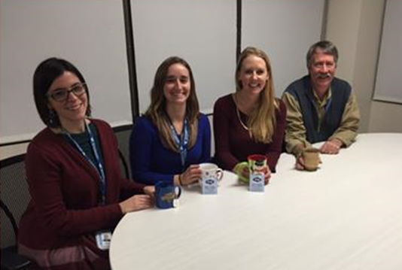
What Is A Workplace Wellness Program?
An organized initiative intended to support the efforts of employees to reach optimal health and wellness.

Slide 6

Raise your hand if…
Notes:
You have an employee wellness program

Slide 7
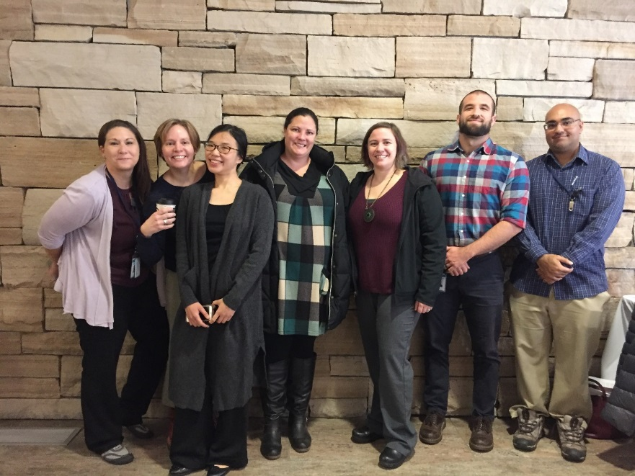
  Benefits of Workplace Wellness
  Increased productivity
  Increased engagement
  Decreased absenteeism
  Controls healthcare costs
  Healthier, happier employees
Notes:
VOI vs. ROI

Slide 8

Don’t get carried away

Slide 9
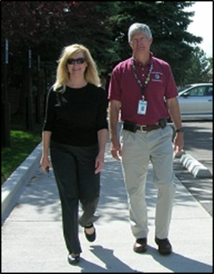
Small Changes Add Up!
Integrate wellness tips into existing meetings (safety, all staff, office, team updates, etc.)
Provide support for breastfeeding moms
  It’s the law!
Provide guidelines for healthy meetings
Allow for scheduling flexibility
Goal! Create supportive policies
Notes:
Healthy choice is easy choice

Slide 10

Why Policies???
Clear Expectations
Consistency
Accountability
Enforceable
Sustainable

Slide 11
Get Started!
Obtain organizational support
Take an employer assessment
Solicit employee feedback
Make a simple plan
Include supportive guidelines, policies
Assess and adapt

Slide 12

Initiative Milestones
Share Results
Sustain Your Work
Get Connected
Get Recognized
Find Your Mission
Learn About Your Organization
Healthy & Productive Workforce
Notes:
To support the coalitions we developed annual milestones
That are based on workplace wellness best practices
The Milestones are
Get Connected
Find Your Mission & Vision
Learn About Your Organization
Share Results
Sustain Your Work
Get Recognized
The circle image represents how employers come to this project at all stages
Participating in the coalitions means they will work on milestones at their sites and at their own pace
when reach certain milestones- they have the opportunities for a mini grant

Slide 13
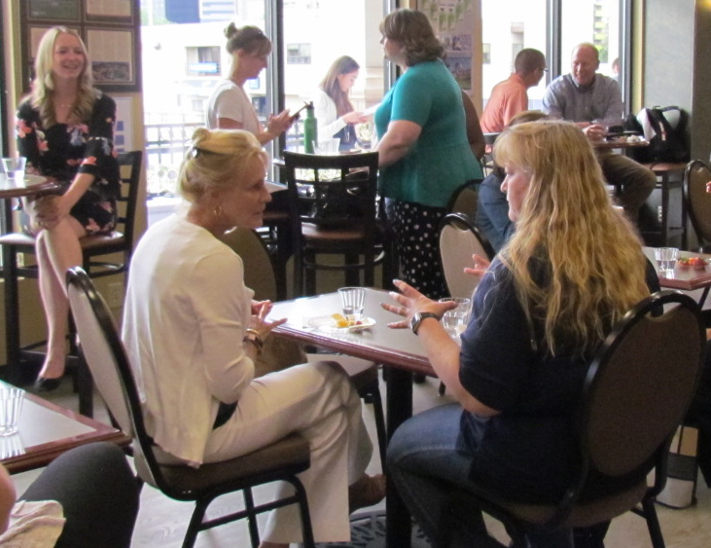
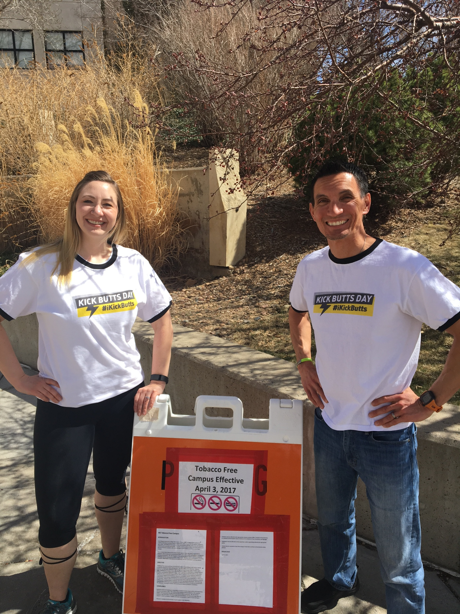
Get Connected
Find Your Mission
Notes:
Get Connected
This milestone means that employers will actively participate in one of Tri-County’s workplace wellness coalitions
and attend meetings regularly
There are no fees associated with participating in a coalition
Find Your Mission & Vision means that employers will make a commitment to
this initiative and
Their organization to support employee well-being changes
Completing this milestone will set them up for success by ensuring that all levels of your organization are supportive of your efforts to create a healthier work environment.

Slide 14
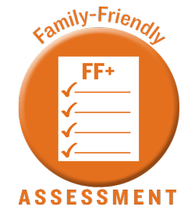

Learn About Your Organization
Workplace Assessment
Share Your Results
“We learned so much about our organization after digging through policies (tobacco/lactation). Our strategy for 2019 will incorporate a lot of the goals identified in the health index.” – Employer Feedback
Notes:
The Learn About Your Organization Milestone means to complete a workplace wellness assessment:
This is a cultural and environmental assessment to help you evaluate your current work environment & employees’ well-bring:
This is a 2 step process:
Step 1. They will take an online workplace assessment (35 min)
We encourage Health Links’ Healthy Business & Family Friendly Assessments and/or
American Heart Association’s Workplace Health Achievement Index
If there is a fee- it will be covered with grant funds
This ranges but averages to about $180 for some assessments
Step 2. Means they will meet with a trained advisor that will review
the assessment results
provide feedback and
suggest next steps
Share Your Results means that employers are provided opportunities and encouraged to share their assessments results with
Other employers during meetings
And with their internal teams (all staff meetings, wellness committee, upper management, HR, etc.)
The quote is from our anonymous survey – We were thrilled with this feedback!

Slide 15
Sustain Your Work
Through the adoption of a workplace well-being policy, procedure, and/or environmental change
Written documentation will increase the likelihood that the changes become part of the workplace culture
“This work with the group helped me bridge the gap from my own efforts to involve HR, insurance, and upper management on a regular basis.” – Employer Feedback
Notes:
A major Milestone requires employers to make attempts to Sustain their Work
This is completed by the adoption of a workplace well-being policy, procedure, and/or environmental change.
As you already know this is it’s own in depth process
We ask them to complete a policy worksheet
This worksheet asks them to
provide evidence of written policies or guidelines that are essential to sustaining work
The worksheet gives them an opportunity to create a snapshot of where their organization is and
identify what their organization needs
Written documentation will increase the likelihood that the changes become part of the workplaces’ culture
I want to call out this quote from the coalition survey

Slide 16
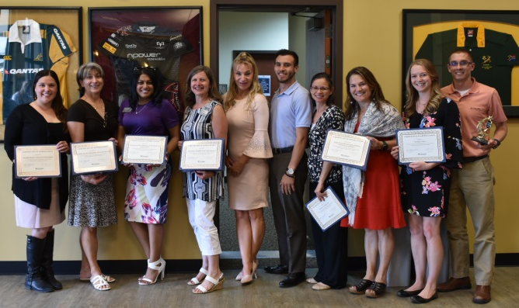
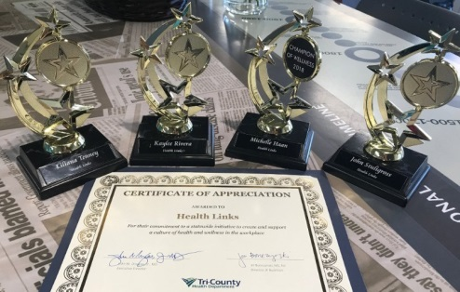
Get Recognized
Local and State-Wide Recognition
“This was a fantastic event. We are honored to be part of such an amazing workplace wellness program.” – Employer Feedback
Colorado Governor’s Award for Worksite Wellness -Wellness Workgroup Coalition: Children’s Hospital Colorado
Health Links Certified Healthy Business Partner -Aurora Coalition: Hilton Garden Inn https://www.youtube.com/watch?v=zSfKS-zaEu4
Notes:
This Milestone mean we will celebrate any/all
Employers will have multiple opportunities to:
Showcase & Receive recognition
for their great work through local and statewide events along with traditional and social media promotion.
Health Links Certified Healthy Business Partner: Hilton Garden Inn: https://www.youtube.com/watch?v=zSfKS-zaEu4 Start at 3:38
Open it up to questions about our coalitions and milestones…
Hand off – Next slide to Michele to explain funding and results. . .

Slide 17
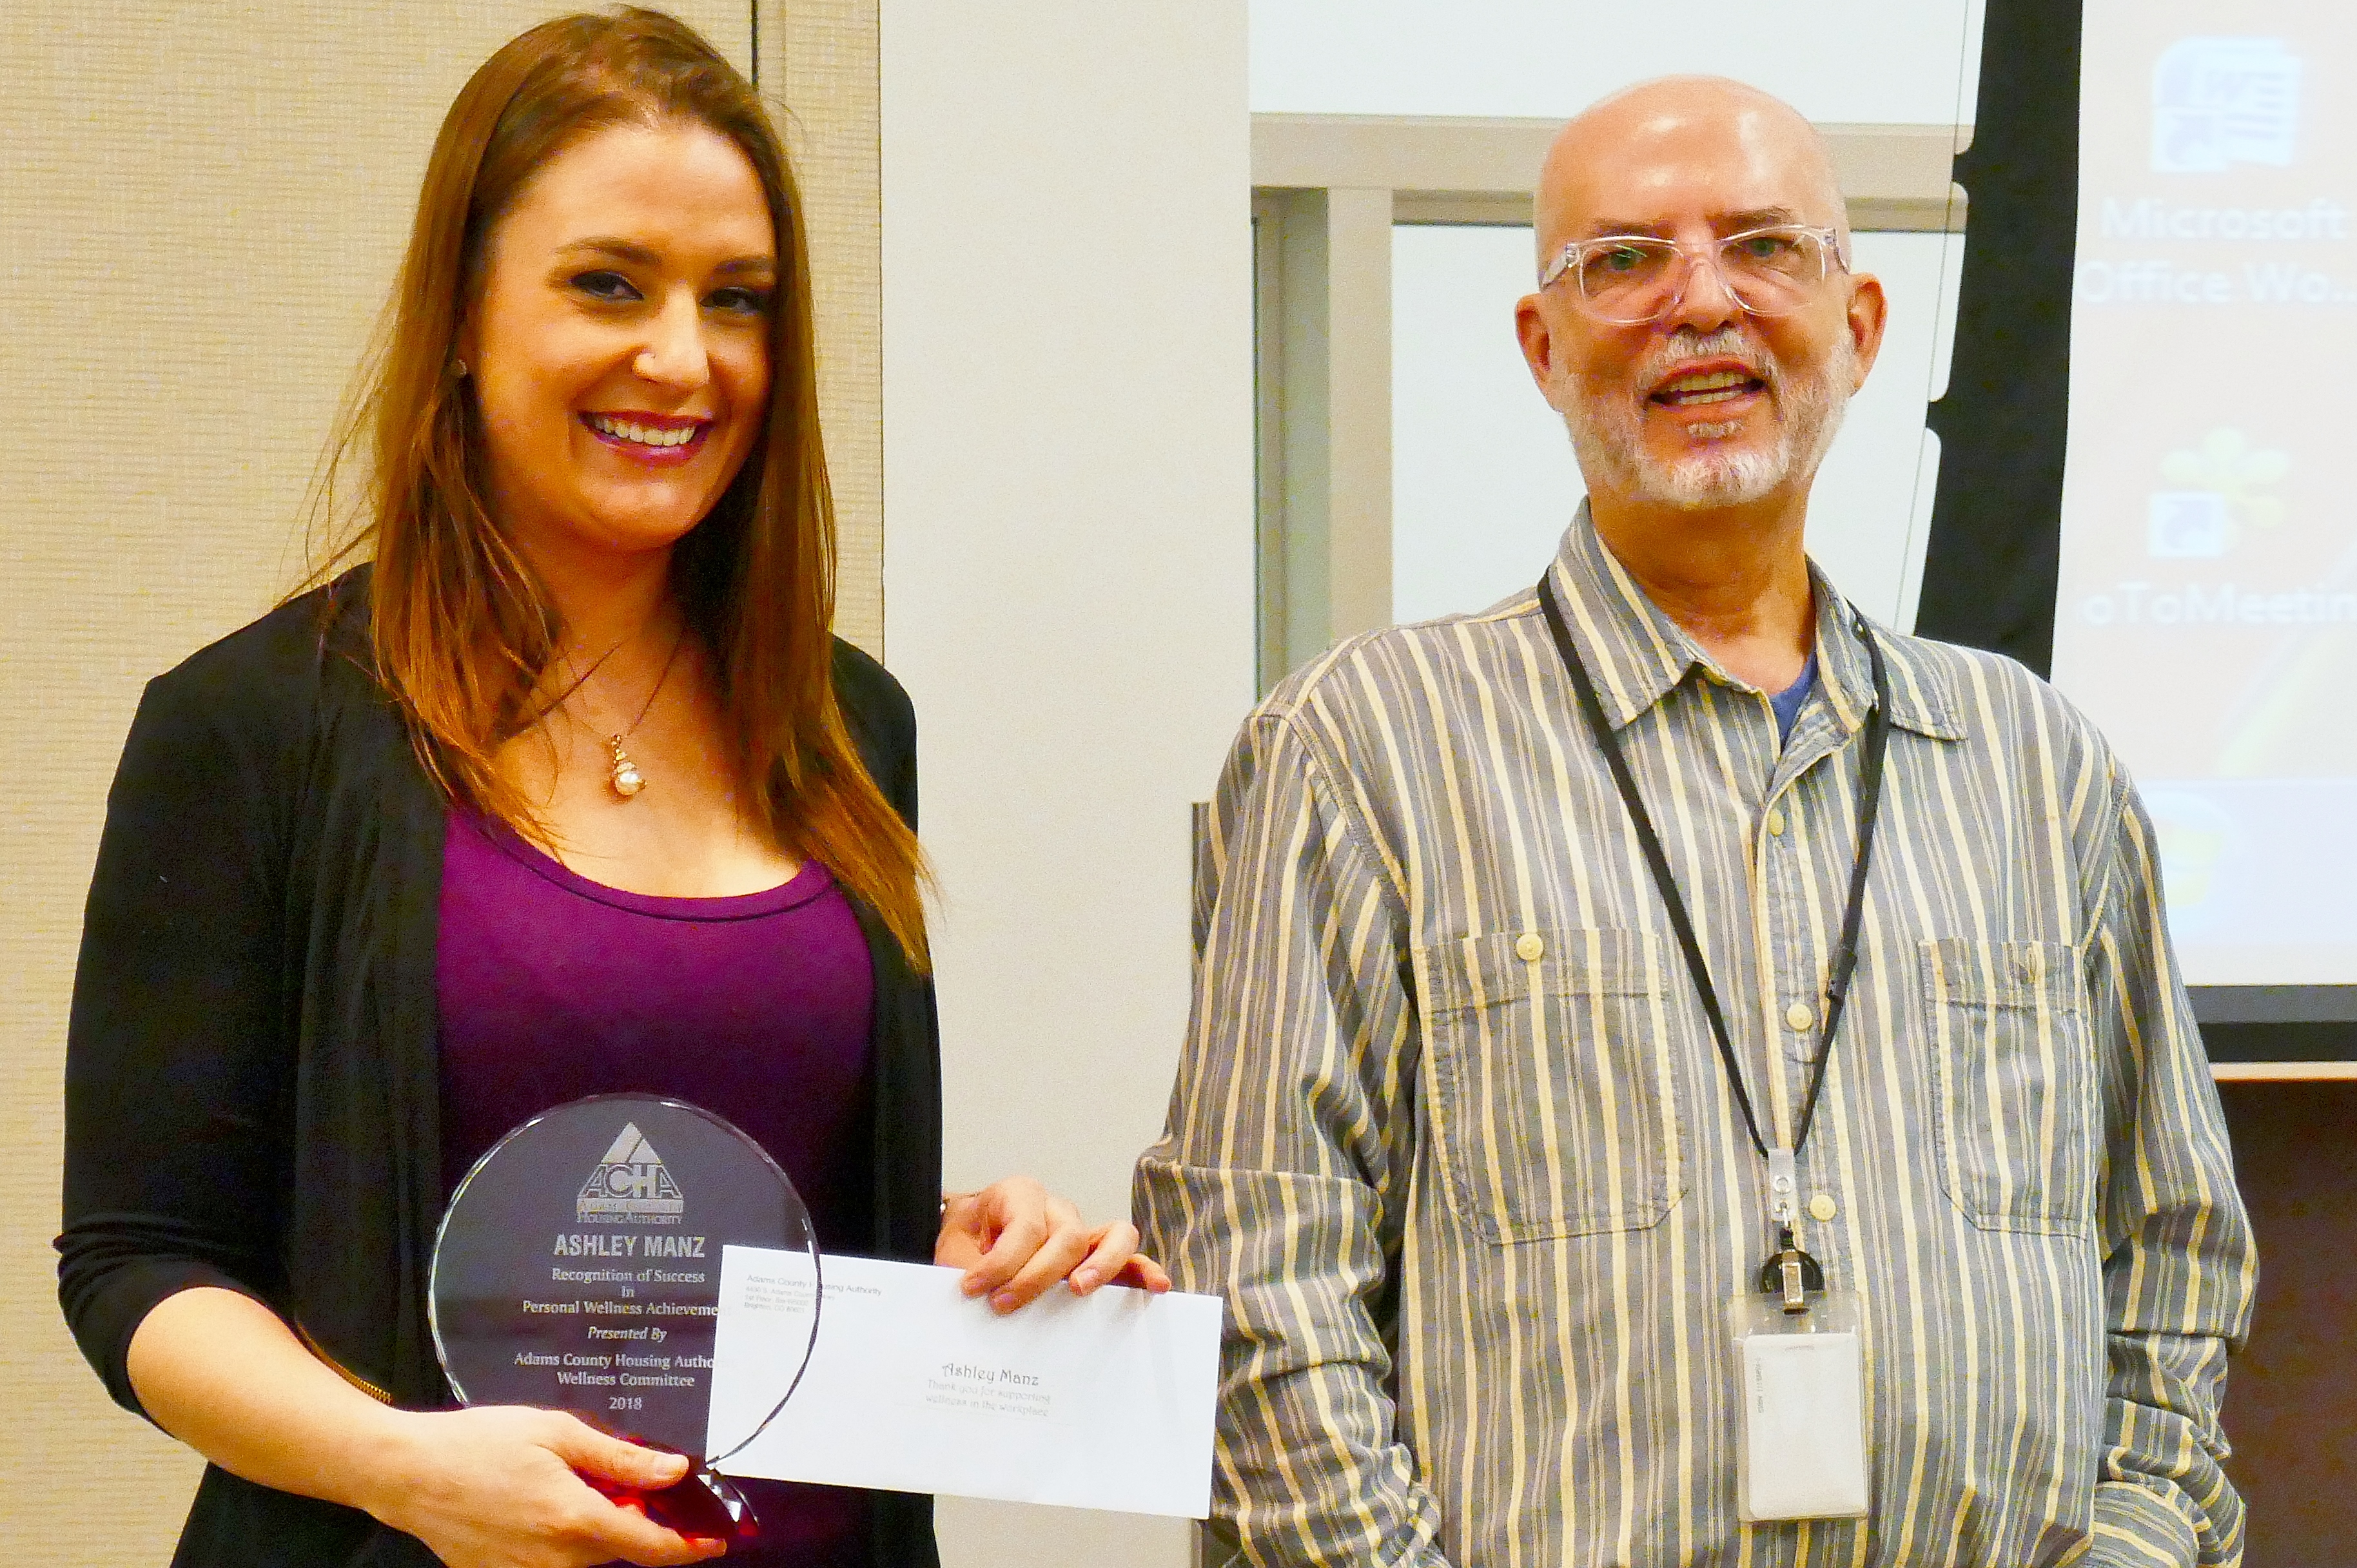
Walking the Talk
Unison Housing Partners in Adams County Colorado
Partners with the Community
Tobacco free policies
  Employee quits smoking
In the works…
Tri-County / Unison WIC co-location
      So much more… Kirk Kemp
Notes:
Along with slide 17, this could be an opportunity to briefly mention some of the other ways TCHD interacts with Unison Housing/housing agencies in general (and encourage increased public health partnership with other housing authorities). E.g. work on radon, Matter of Balance, diabetes education, food systems, substance abuse prevention, plus Health and Housing is one of TCHD’s new priorities in our Public Health Improvement Plan.

Slide 18
Unison Wellness Committee – Voluntary
Support of Management
Monthly Challenges – Competitive
Monthly Challenges – Non-Competitive
Tasty Tuesday Emails
Monthly Wellness Newsletter
Yearly Wellness Award
Summer Activity Challenge
Current Project – Grant – Closet into Zen/Meditation/Lactation Space

Slide 19
MONTHLY CHALLENGES
Adult Coloring – Stress Relief
Drink More Water
Drop Pop – No Soda for 30 Days
Healthy Eating – Tracking Veggie Intact
Holiday Eating – Thanksgiving to New Years
Move It – 5,000 Steps a Day
Random Acts of Kindness – Strangers or Non-Associates
Risky Business - Evaluate Insurance Coverage
Smoking Cessation
Stretch Yourself – Stretch Every Hour
Take the Stairs
Thankfulness – List 3 Items Per Day
Competitive
Emails – 3 x Week
Goal Driven
Honor System
Awards/Prizes
Team or Individual
Non-Competitive
Emails – 3 x Week
Self Rewarding
Self Goal Setting

Slide 20

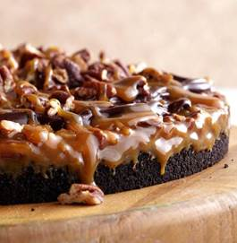
TASTY TUESDAY
Healthier
Fresh Ingredients
Ingredient List: Short & easily found
Directions – Short & Easy
Taken from Wellness Websites
Requested:
  Vegan
  Gluten Free
  Non-Dairy
Occasionally Something Decadent!
VEGETARIAN GLUTEN FREE
ZUCCHINI MUFFINS
INGREDIENTS:
3/4 cup thickener such as potato starch (kosher), or cornstarch, arrowroot or tapioca starch
1 and 1/4 cups ground almonds
1 cup sugar
1 teaspoon baking powder
1 teaspoon baking soda
1 teaspoon ground cinnamon
1/2 teaspoon salt
½ cup oil and ½ cup applesauce
4 eggs
1/2 cup maple syrup
2 small zucchinis, peeled and shredded
INSRUCTIONS:
Preheat oven to 350 degrees Fahrenheit (180 degrees Celsius).
In a large bowl, combine potato starch, ground almonds, sugar, baking powder, baking soda, cinnamon, and salt.
In a separate bowl, whisk the oil, eggs, and maple syrup together.
Stir into the dry ingredients until just moistened. (Do not overmix, as this causes settling.)
Fold in the shredded zucchini.
Fill lined muffin tins almost to the top.
Bake for 30 minutes.

Slide 21
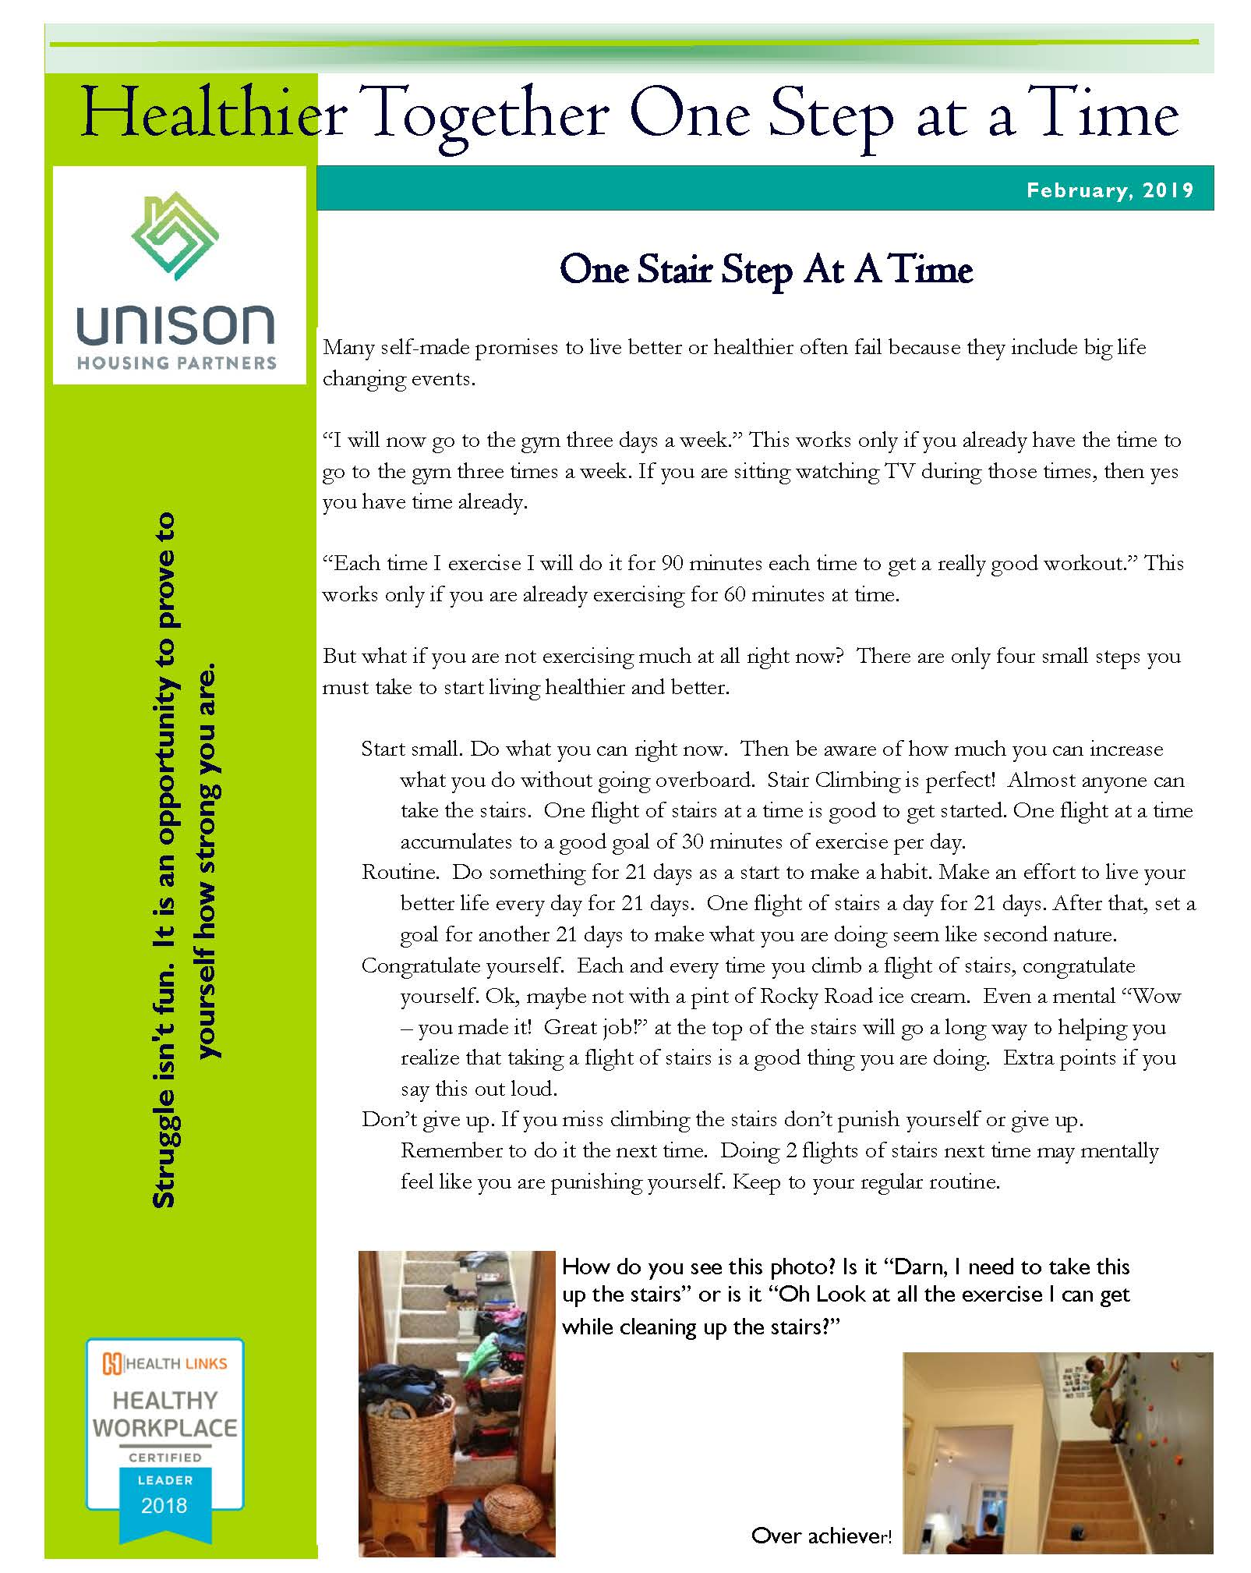


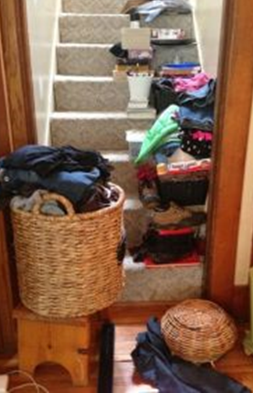
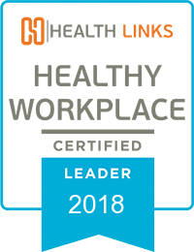
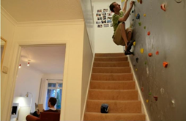
MONTHLY NEWSLETTER
One Page
Email
English and Spanish
Taken from Wellness Websites or Original
Helpful, inspirational
Touch of Humor
Healthier Together One Step at a Time
Healthier Together One Step at a Time
One Stair Step At A Time
One Stair Step At A Time
Many self-made promises to live better or healthier often fail because they include big life changing events.
“I will now go to the gym three days a week.” This works only if you already have the time to go to the gym three times a week. If you are sitting watching TV during those times, then yes you have time already.
“Each time I exercise I will do it for 90 minutes each time to get a really good workout.” This works only if you are already exercising for 60 minutes at time.
But what if you are not exercising much at all right now? There are only four small steps you must take to start living healthier and better.
Start small. Do what you can right now. Then be aware of how much you can increase what you do without going overboard. Stair Climbing is perfect! Almost anyone can take the stairs. One flight of stairs at a time is good to get started. One flight at a time accumulates to a good goal of 30 minutes of exercise per day.
Routine. Do something for 21 days as a start to make a habit. Make an effort to live your better life every day for 21 days. One flight of stairs a day for 21 days. After that, set a goal for another 21 days to make what you are doing seem like second nature.
Congratulate yourself. Each and every time you climb a flight of stairs, congratulate yourself. Ok, maybe not with a pint of Rocky Road ice cream. Even a mental “Wow – you made it! Great job!” at the top of the stairs will go a long way to helping you realize that taking a flight of stairs is a good thing you are doing. Extra points if you say this out loud.
Don’t give up. If you miss climbing the stairs don’t punish yourself or give up. Remember to do it the next time. Doing 2 flights of stairs next time may mentally feel like you are punishing yourself. Keep to your regular routine.
Many self-made promises to live better or healthier often fail because they include big life changing events.
“I will now go to the gym three days a week.” This works only if you already have the time to go to the gym three times a week. If you are sitting watching TV during those times, then yes you have time already.
“Each time I exercise I will do it for 90 minutes each time to get a really good workout.” This works only if you are already exercising for 60 minutes at time.
But what if you are not exercising much at all right now? There are only four small steps you must take to start living healthier and better.
Start small. Do what you can right now. Then be aware of how much you can increase what you do without going overboard. Stair Climbing is perfect! Almost anyone can take the stairs. One flight of stairs at a time is good to get started. One flight at a time accumulates to a good goal of 30 minutes of exercise per day.
Routine. Do something for 21 days as a start to make a habit. Make an effort to live your better life every day for 21 days. One flight of stairs a day for 21 days. After that, set a goal for another 21 days to make what you are doing seem like second nature.
Congratulate yourself. Each and every time you climb a flight of stairs, congratulate yourself. Ok, maybe not with a pint of Rocky Road ice cream. Even a mental “Wow – you made it! Great job!” at the top of the stairs will go a long way to helping you realize that taking a flight of stairs is a good thing you are doing. Extra points if you say this out loud.
Don’t give up. If you miss climbing the stairs don’t punish yourself or give up. Remember to do it the next time. Doing 2 flights of stairs next time may mentally feel like you are punishing yourself. Keep to your regular routine.
Struggle isn't fun. It is an opportunity to prove to yourself how strong you are.
Struggle isn't fun. It is an opportunity to prove to yourself how strong you are.
How do you see this photo? Is it “Darn, I need to take this up the stairs” or is it “Oh Look at all the exercise I can get while cleaning up the stairs?”
How do you see this photo? Is it “Darn, I need to take this up the stairs” or is it “Oh Look at all the exercise I can get while cleaning up the stairs?”
Over achiever!
Over achiever!

Slide 22
AWARDS
COMPETITIVE CHALLENGES
Award To Each Team Participant
Award To Solo Participant
Award To Any Participant
Award - $50-$75 Gift Card to Sprouts Market
YEARLY WELLNESS AWARD
Nominated by ANY co-worker
Personal Achievement In Any Area of Wellness
Community Involvement In Any Area of Wellness
  Glass/Crystal Trophy - $130
  Gift Certificate - $100

Slide 23

Available on YouTube!
Is your summer going to be filled with fun and excitement?

Slide 24



HIKING HAWAII !
Five Week Virtual Walking Team Challenge

Slide 25

Hawaii has 860 miles of Beautiful Coastline
We will ignore those pesky sheer cliffs that rise up out of the Ocean, those irritating lava flows, and private land owners shouting “GET OFF MY BEACH!”

Slide 26
Aerobics, high impact | 203 | Orienteering | 260
Aerobics, low impact | 145 | Painting | 131
Aerobics, step | 246 | Pilates | 101
Badminton, casual | 131 | Ping-pong | 116
Badminton, competitive | 203 | Racquetball, casual | 203
Basketball, game | 230 | Racquetball, competitive | 290
Basketball, recreational | 174 | Raking leaves | 125
Bicycling, leisurely | 116 | Roller skating | 203
Bicycling, stationary | 203 | Rowing, light | 101
Bowling | 87 | Rowing, moderate | 203
Boxing | 348 | Running, 10 mph (6 min/mile) | 463
Canoeing, light | 87 | Running, 8 mph (7.5 min/mile) | 391
Chopping wood, around home | 174 | Running, 6 mph (10 min/mile) | 290
Circuit Training | 232 | Running, 5 mph (12 min/mile) | 232
Cross-country skiing, intense | 260 | Scuba diving | 203
Cross-country skiing, moderate | 232 | Show shoveling | 174
Cross-country skiing, slow | 203 | Snowboarding, light | 150
Dancing | 131 | Snowboarding, moderate | 182
Downhill skiing | 174 | Soccer, recreational | 203
Elliptical trainer | 203 | Soccer, competitive | 290
Firewood, carrying | 145 | Softball | 145
Firewood, sawing with handsaw | 217 | Squash | 348
Firewood, stacking | 145 | Stair climbing, machine | 260
Football | 260 | Stair climbing, moderate | 334
Gardening, light | 116 | Stair climbing, slow | 232
Gardening, heavy | 174 | Stair climbing, vigorous | 434
Gardening, weeding | 131 | Stretching | 72
Golfing, without a cart | 131 | Swimming, backstroke | 203
Golfing, with a cart | 101 | Swimming, breaststroke | 290
Grocery Shopping | 67 | Swimming, butterfly | 319
Handball | 348 | Swimming, freestyle | 203
Hiking, 10-20 lb. load | 217 | Swimming, leisure | 174
Hiking, 21-42 lb. load | 232 | Swimming, treading water | 116
Hiking, general | 172 | Tae Kwon Do | 290
Horseback riding | 116 | Tai Chi | 116
Horseback riding, trotting | 188 | Tennis, doubles | 174
Housework, light | 72 | Tennis, singles | 232
Housework, mopping floors | 101 | Trampoline | 101
Housework, scrubbing floors | 110 | Volleyball, game | 232
Housework, vacuuming | 101 | Volleyball, leisure | 87
ACTIVITY CHART
(Number of steps per minute for selected activities)
REMEMBER:
2,200 STEPS = 1 MILE
1 MILE = 15 MINUTES OF BRISK WALKING

Slide 27

PARTICIPANT TRACKING LOG
Number of Steps Per Day:
ENROLLMENT FORM
 |  | Week 1 | Week 2 | Week 3 | Week 4 | Week 5
Monday
Tuesday
Wednesday
Thursday
Friday
Saturday
Sunday
TOTAL
Name:______________________________________________
Location:____________________________________________
Team Captain’s Name:______________________________________________
Team Name: ____________________________________________________
How to Participate:
Wear your pedometer every day while walking or doing any activity.
At the end of the day, or first thing in the morning, enter your daily total in the chart above.
On Monday morning send your total number of steps
IT IS REALLY THAT SIMPLE!
I understand that my participation in HIKING HAWAII is completely voluntary and I hold my employer harmless, should I be injured due to my participation in this program.
SIGNATURE:_____________________________________________

