Slide 1
Affordable Housing Developments in Action

Slide 2
Affordable Housing Developments in Action
• MISSION:
Solvera provides ‘value added’ financial and real estate development consulting services to non-profit and housing authority owners for the creation and preservation of affordable rental housing.
• VALUES:
• Expertise
• Integrity
• Passion

Slide 3
Affordable Housing Developments in Action
• Partners:
• Bob Munroe
• Greg Glade
• Lisa Mullins
• Mike Gerber

Slide 4
Affordable Housing Developments in Action
Solvera offers a broad spectrum of consulting services ranging from ‘turnkey’ development for new rental housing projects to the acquisition, restructuring, refinancing and preservation of existing communities and portfolios.
We tailor these services to meet the needs of our clients, which range from large owner/developers to small, community-based organizations.

Slide 5
Affordable Housing Developments in Action
Solvera works in a variety of ways to best serve its clients’ needs in managing the financial analysis and/or development process of both new construction, and acquisition/rehabilitation projects as well as property portfolios.
We not only assist the Sponsor with detailed financial and development analysis, we coordinate the project’s pre-development schedule, funding application preparation and presentation processes, negotiations, closing and funding of all sources of funds, as well as construction management.

Slide 6
Affordable Housing Developments in Action
Representative Transactions
1. Marston Pointe
2. Victor F. Smith Senior Housing
3. Villas at the Bluffs II
4. Lumien Apartments

Slide 7
Affordable Housing Developments in Action
Marston Pointe
Number of Units: 160
Number of Buildings: 8 3-story, walk-ups
Year Built: 1998
Land Size: 8.77 Acres
Unit Mix: 48 – 1Bd/1Ba
16 – 2Bd/1Ba
80 – 2Bd/2Ba
16 – 3 Bd/2Ba
Amenities: Swimming Pool, Fitness Center, Playground, Community building.

Slide 8
Affordable Housing Developments in Action
Marston Pointe
Owner/Client: Metro West Housing Solutions
Acquisition with light rehab.
Acquisition and Financial Consulting.
Existing Affordability: 40% at 60% AMI
60% at Market
New Affordability: 60% at 60% AMI
40% at Market
Financing Structure: Taxable Acquisition loan from a commercial bank; initial PAB and 4% LIHTC resyndication analysis.

Slide 9
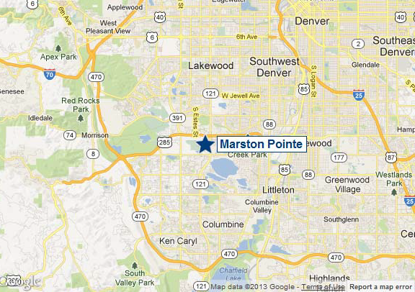
Affordable Housing Developments in Action

Slide 10
Affordable Housing Developments in Action

Slide 11
Affordable Housing Developments in Action
Victor F. Smith Senior Housing
Number of Units: 30
Number of Buildings: 6 1-story buildings
Year Built: 12 units in 2001
New Construction: 18 units
Land Size: 3.2 Acres
Unit Mix: 30 – 1Bd/1Ba
Amenities: Outdoor Community Area, Community Room, Library, Washer/Dryers in all Units, Air Conditioning

Slide 12
Affordable Housing Developments in Action
Victor F. Smith Senior Housing
Owner/Client: Brothers Redevelopment, Inc. Acquisition/Rehab and New Construction.
Acquisition, New Development and Financial Consulting.
Affordability: 1 unit @ 30% AMI; 1 unit @ 35% AMI; 1 unit @ 45% AMI;
8 units @ 50% AMI; 19 units @ 60% AMI; will have up to 9 project based vouchers through G/WHA.
Finance Structure: 9% LIHTC, Conv. Perm Loan, CDOH funds, Town of Erie funds

Slide 13
Affordable Housing Developments in Action

Slide 14
Affordable Housing Developments in Action

Slide 15
Affordable Housing Developments in Action

Slide 16
Affordable Housing Developments in Action

Slide 17
Affordable Housing Developments in Action
Villas at the Bluff II
Number of Units: 32 plus Phase I – 48 units
Number of Buildings: 4 2-story buildings
Year Built: New Construction 2015
Land Size: 3.5 Acres
Unit Mix: 12 – 1Bd/1Ba; 16 – 2Bd/2Ba; 4 – 3Bd/2Ba
Amenities: Outdoor Community Area, Community Room, Library, Washer/Dryers in all Units, Air Conditioning

Slide 18
Affordable Housing Developments in Action
Villas at the Bluff II
Owner/Client: Delta Housing Authority New Construction.
New Development and Financial Consulting.
Affordability: 3 units @ 30% AMI; 4 units @ 40% AMI; 13 units @ 50% AMI; 12 units @ 60% AMI.
Financing Structure: 9% LIHTC, CHFA Perm Loan, CDOH funds.

Slide 19
Affordable Housing Developments in Action

Slide 20
Affordable Housing Developments in Action

Slide 21
Affordable Housing Developments in Action

Slide 22
Affordable Housing Developments in Action

Slide 23
Affordable Housing Developments in Action

Slide 24
Affordable Housing Developments in Action
Lumien Apartments
Number of Units: 50 units; planned for 90 units total; 2,500 sq. ft. commercial
Number of Buildings: 1 3-story building
Year Built: New Construction 2015
Land Size: 3.09 Acres
Unit Mix: 25 – 1Bd/1Ba; 25 – 2Bd/1Ba
Amenities: Outdoor Community Area, Community Rooms, Washer/Dryers in all Units, Air Conditioning, Elevator

Slide 25
Affordable Housing Developments in Action
Lumien Apartments
Owner: Solvera Advisors
Client: La Plata Homes Fund
New Construction.
New Development and Financial Consulting.
Affordability: 5 units @ 30% AMI; 15 units @ 50% AMI; 30 units @ 60% AMI.
Financing Structure: 9% LIHTC, CHFA Perm Loan, CDOH funds.

Slide 26
Affordable Housing Developments in Action

Slide 27
Affordable Housing Developments in Action

Slide 28
Affordable Housing Developments in Action

Slide 29
Affordable Housing Developments in Action

Slide 30
Affordable Housing Developments in Action

Slide 31
Affordable Housing Developments in Action

Slide 32
Affordable Housing Developments in Action

Slide 33
Affordable Housing Developments in Action

Slide 34
Affordable Housing Developments in Action
Questions?

