Slide 1
Protecting Tenants Through Legislative Efforts
SPEAKERS
MODERATOR: Cathy Alderman, Vice President of Communications and Public Policy, Colorado Coalition for the Homeless
Tiana Patterson, State and Local Policy Program Director, Enterprise Community Partners
Jack Regenbogen, Family Economic Security Attorney & Policy Advocate, Colorado Center on Law and Policy
Aubrey Hasvold, Advocacy Program Manager, Colorado Coalition for the Homeless
Christina Garcia, Director of Housing Counseling Services, Colorado Coalition for the Homeless
Colorado has some of the fewest renters’ protections laws in the country. Hear from statewide advocates who have been working at local and state levels to remedy that and provide better legal protections for tenants in Colorado.

Slide 2
Warranty of Habitability Legislation
Tiana Patterson, J.D. State & Local Policy Director--Colorado
Enterprise Community Partners
Notes:
Who I am– who & what ECP does

Slide 3
What is Warranty of Habitability?
Notes:
Just to have some level setting– I wanted to share what I think is a pretty good basic overview of what warranty of habitability is in landlord tenant law.

Slide 4
Why Warranty of Habitability (WOH) ?
In 2017, Enterprise Released a report called “Protecting CO Renters: A Call for Action on State & Local Policy” that report was informed by our partners at 9to5, United for a New Economy, and Mile High Connects.
Housing quality issues rose to the top
Safe and Healthy homes have direct impact on the lives and well beings of families
These were cost-neutral proposals that could help thousands
Colorado ranks near the bottom for tenant protections.
Notes:
Enterprise chose to work on this piece of landlord tenant law because due to a few factors. One we released a report in 2017, that was a comprehensive scan of the policy changes that needed to be made in Colorado in order to get landlords and tenants on more equal footing. In particular, a survey done by 9to5 Colorado where they surveyed almost 1,000 residents of public and private housing and asked them what their biggest housing concerns/issues were. Also we were hearing a lot from the young people who moved here from cities like Seattle, LA, DC and Chicago that they were shocked with how little rights tenants had in the event of a housing quality issue compared with those other states. Housing quality and maintenance issues rose to the top time and time again. We thought that this would make a great impact for renters and bring CO in line with other states in terms of warranty of habitability guidelines.

Slide 5
Current WOH Statute v. 2019 Updates– HB19-1170
Tenant gives written notice to landlord. Electronic notice is invalid.
Tenant waits a “reasonable amount of time.”
No distinction between emergency or non emergency repairs in current statutory language.
Tenant must let a district court know that they intend to take action against landlord.
After a reasonable amount of time passes,
A tenant can try to:
Abate rent: post bond with the court to abate rent, give notice, and get ready to go to court
Break lease: a tenant must tell the district court about the problem, give the landlord another notice outlying the habitability issue, and then give the landlord another (10-30 days) notice of tenant’s intent to vacate.
No matter which option the tenant chooses, she will likely end up in court and encounter the court’s presumption of good faith on behalf of the landlord.
Colorado’s current law involves the courts early in the process
Often, landlords and tenants do not have a chance to resolve disputes themselves
Written notice includes email, text, and resident portals and validates electronic communication between landlords and tenants. Notice must be outlined and followed per the lease agreement.
Emergency repairs have specific and reasonable timelines depending on the issue.
10 days for all other repairs.
Tenants must let County and/or District Courts know of their intent to take action
The landlord must respond in a timely manner and give an estimate of timelines of repairs, if LL is unable to cure the issue within the prescribed timelines, the landlord may provide a written explanation of the delay.
If the notice period lapses without communication from the landlord,
The Tenant may:
Get a professional estimate for the cost of repair and
Give landlord notice of their intent to withhold
The Landlord may:
Get their own estimate for repairs
Repair the issue and stop the habitability claim
If the case goes to court, there is no presumption for either party. Each party is responsible for proving their claims/defenses before a judge.
Colorado’s new law will provide for more opportunities to resolve the dispute outside of the courts.
Landlords and Tenants are encouraged to communicate and work together to resolve disagreements.
Notes:
On the left is the current WOH statute provisions and on the right are the 2019 updates that passed out of the 2019 state legislative session. This side by side comparison really shows out methodical thought process towards injecting greater parity, communication and fairness throughout this entire bill update. You’ll notice there is an emphasis on modernization with electronic notice, we also updated that the terms of notice as it has to be outlined in the lease contract and we gave each party options in terms of dealing with habitability issues.
In the handout you will see– mold has been listed as condition that could breach warranty, there is a prohibition on retaliation for tenants who make habitability claims, and of particular interest to this group– tenants of federal or state subsidized properties through programs like State and Federal LIHTC programs, HOME, or some other program that restricts max. rents or is subject to compliance monitoring are not allowed to withhold rent not hire someone to make repairs under warranty. However, these properties are subject to the quality and notice requirements under this bill. Tenants with housing choice vouchers who live in private housing are allowed to withhold.

Slide 6
Engagement Process
Over the past two years we garnered feedback from:
Apartment Association
Home builders
Housing authorities
Health experts
Lawyers
Model legislation from at least 10 other states.
Community members
Why did we work to have such a robust outreach strategy?
Fairness
Transparency
Political feasibility
Notes:
As I said earlier, this was a robust process centered in fairness and equitable remedies in the event of unfair treatment by landlords. The bill is over 22 pages long because we also beefed up remedies for landlords where a tenant causes the habitability issue, that is why we had such a robust 2 year engagement process and tried to ensure that this really elevated the landlord tenant relationship. We wanted to push back on the perception that this was an effort to tip the scales towards one group, we engaged with all groups to ensure that the changes were fair, reasonable, and based both on community & expert feedback, but also on logic and robust legal analysis.

Slide 7
Making the Connection
WHY?
Family Economic Vitality
Health & Wellness of Family
Mitigation of Displacement
Ending Intergenerational & Multigenerational poverty
Notes:
I think the question I get asked most often is why did we do this? This really came out of the understanding that when families have safe and healthy homes they remain more stable, thereby being able to save money and possibly access greater economic opportunity which cannot happen when all their money is going to medical bills because of a mold infestation or rodent infestation. Studies have shown that families who live in subpar housing suffer parents and children experience greater stress and major impacts to their mental well being. Why not create a policy that goes unequivocally states that all people, but especially people of color and those living in poverty deserve to live in housing that gives them hope for them and future generations and beyond that, fosters greater vitality and access to opportunity so that they could move up the economic ladder? That was the push for me and I am sure from many of my colleagues that you will hear from to for creating legislation that established greater tenant protections in for residents across Colorado.
Thank you

Slide 8
2019 Renters’ Protections Legislative Overview
Jack Regenbogen, Colorado Center on Law and Policy

Slide 9
Eviction Legal Defense Fund (SB19-180, sponsored by Sen. Faith Winter and Rep. Julie McCluskie)
The bill provides $750,000 to create an Eviction Legal Defense Fund.
The Office of the State Court Administrator will award grants from the fund to qualifying nonprofit organizations that provide legal advice, counseling, and representation for, and on behalf of, indigent clients who are experiencing an eviction or are at immediate risk of an eviction.

Slide 10
Extend Notice Before an Eviction (HB19-1118, sponsored by Rep. Dominique Jackson, Rep. Rochelle Galindo and Sen. Angela Williams)
This bill extends the amount of time a renter has to pay rent or cure a lease violation before an eviction, from 3 days to 10 days.
If a landlord owns five or fewer single family homes, they may provide 5 days notice if this timeframe is disclosed in a lease agreement.
** This does not apply to nonresidential leases or employer-provided housing.
** A tenant may still be evicted sooner if behavior is threatening safety or property.

Slide 11
Residential Tenants Health and Safety Act (HB19-1170, sponsored by Rep. Dominique Jackson, Rep. Mike Weissman, Sen. Angela Williams and Sen. Jeff Bridges)
This bill provides a meaningful process for enforcing the “warranty of habitability,” which is the basic standard for healthy and safe housing that a landlord is responsible for maintaining.
It establishes timeframes for a landlord to commence repairs and allows a renter to withhold rent if needed.
It makes it easier for a tenant to access relief through the courts.
It requires a landlord to provide a working refrigerator and oven if included in the lease, and it requires a landlord to address issues related to mold.

Slide 12
Rental Application Fees (HB19-1106, sponsored by Rep. Serena Gonzales-Gutierrez, Rep. Brianna Titone and Sen. Brittany Pettersen)
This bill limits what a landlord can charge as a “rental application fee” to the actual costs of screening a prospective tenant.
It requires a receipt of expenses, a refund if someone’s application is not considered, and a notice that explains why someone was denied housing.
It prohibits consideration of rental and credit history older than 7 years.
It prohibits consideration of any arrests that do not result in a conviction.
It prohibits consideration of criminal convictions older than 5 years, with limited exceptions.

Slide 13
Grants for Property Tax, Rent, and Heat (HB19-1085, sponsored by Rep. Tony Exum and Sen. Rachel Zenzinger)
This bill increases funding and expands eligibility to qualify for assistance under the Property Tax, Rent, Heat Credit Rebate (PTC Rebate), which is available to low-income older adults and people with disabilities.
It increased the income-eligibility thresholds and grant amounts by 5% and indexed the amounts to increase with inflation in the future.
It expands eligibility to people living in nonprofit housing.

Slide 14
Landlord And Tenant Duties Regarding Bed Bugs (HB19-1328, sponsored by Rep. Leslie Herod and Sen. Robert Rodriguez)
This bill establishes responsibilities, processes and timeframes for addressing a bed bug infestation.
Landlords are generally responsible for the cost of treating a bed bug infestation, though the tenant is responsible for notifying the landlord and preparing a unit for treatment.
A landlord must have a unit inspected within 96 hours of receiving notice that it may be infested.
A landlord must also disclose to a prospective tenant if there is reason to believe a unit is infested.

Slide 15
Authorize Local Governments to Stabilize Rent (SB19-225, sponsored by Sen. Julie Gonzales, Sen. Robert Rodriguez, Rep. Serena Gonzales-Gutierrez and Rep. Susan Lontine)
This bill did not pass, but would have given counties and municipalities the authority to enact ordinances intended to stabilize the cost of rent.
It would have authorized local governments to enact and enforce any ordinance, resolution, agreement, deed restriction, or other measure that would stabilize rent on private residential property.

Slide 16
Mobile Home Park Act Oversight (HB19-1309, sponsored by Rep. Edie Hooten, Rep. Julie McCluskie, Sen. Stephen Fenberg and Sen. Pete Lee)
This bill provides for state oversight over the Mobile Home Park Act, and it establishes an administrative process within the Division of Housing for mobile home park tenants to seek relief if their rights are violated.
This bill changes some of the timeframes for the eviction of a mobile home park tenant: it expands the time to pay rent before an eviction from 5 days to 10 days, and increases the time to move or sell a home after an eviction from 2 days to 30 (with the option of purchasing an additional 30 days).
It gives counties legal authority to regulate mobile home parks in unincorporated areas.

Slide 17
HB 1118 – Engaging LandLords and People with Lived Experience
Aubrey Hasvold, Colorado Coalition for the Homeless

Slide 18
Advocacy Case Study: HB19-1118
It is a policy solution that balances the landlord/tenant relationship.
Most landlords are good actors and can be a model for renters’ protections bills.

Slide 19
Background on HB19-1118
The best way to address homelessness is to prevent it from happening in the first place.
Attorneys from Denver’s Eviction Legal Defense Program reported that 3 day’s notice is insufficient.
This short timeframe also undermines the effectiveness of existing rental assistance programs.
Most states have longer notice/cure periods than Colorado

Slide 20
Barbara Carlson, Landlord
“…because we are all human, sometimes emergencies and setbacks happen. The law should reflect the understanding and flexibility many landlords already give their tenants when layoffs, loss of public benefits or medical issues occur.”

Slide 21
Emilie Aries, Landlord
“Before [becoming a landlord], I had to honestly consider the risks: what would happen if rent was not paid on time? What would I do? How would my business go on? … The bottom line is, if my renters are a few days late on rent, or even a few weeks late on rent, I won't lose my home.”

Slide 22
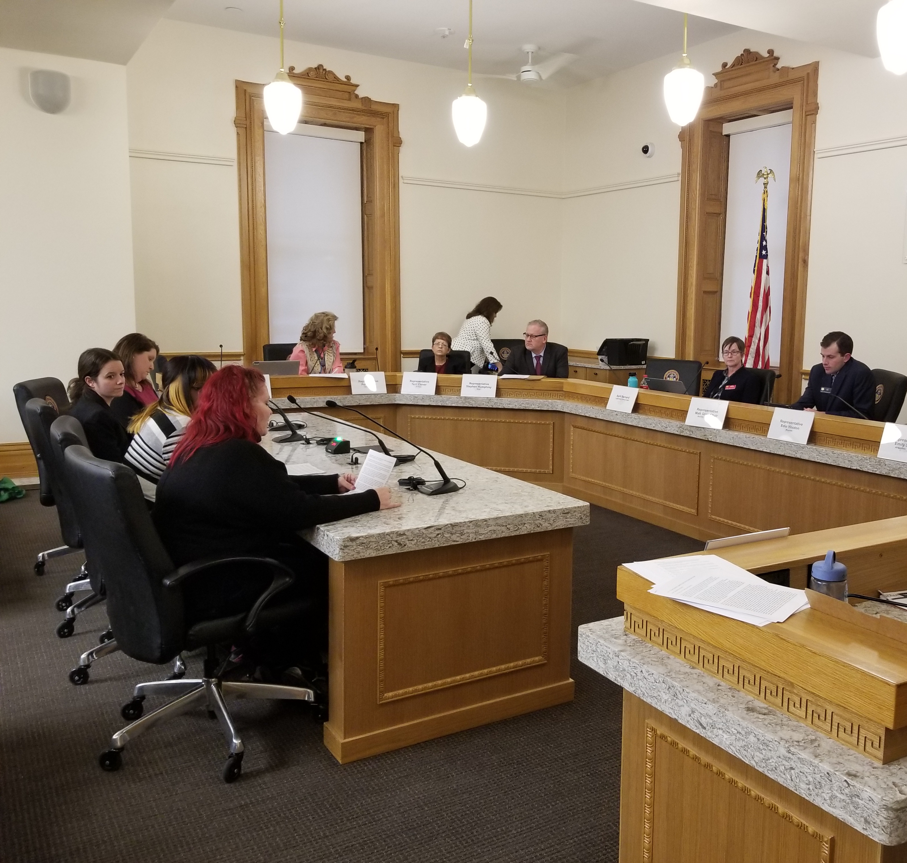
Melissa Jones, Tenant
“I believe strongly that this bill will help the hard working families that live paycheck to paycheck, the disabled men and woman like myself that have heath conditions that can't move that fast or get help to move that fast. [It will give people] time to get the money up and resolve the issues that are leading them to homelessness and worsening the housing crisis.”

Slide 23
Future Legislation: Source of Income Non-Discrimination
This legislation would ensure that a person’s source of income does not preclude them from accessing housing.
According to Denver Housing Authority, 22 percent of vouchers expire because the holder is not able to find a place to live.
When protections are in place, voucher utilization increases by up to 11 percent.

Slide 24
Assessing the Impacts
Christina Garcia, Colorado Coalition for the Homeless

Slide 25
Housing Vouchers in the Community
Common Challenges
Discrimination/misperception
High rents/low inventory
Payment Standard vs. FMR
Landlord not part of care team
Damages to units

Slide 26
After SOI Ordinance
Higher rents
Security deposits upfront
Holding fee/admin fees
3x tenant portion
Tougher background screening

Slide 27
Housing Strategies
Dedicated Housing Navigation
Intentional housing with Housing Coordinators taking point
Quick access to $ for app/admin/holding fees

Slide 28
Eviction Prevention work starts before someone is housed

Slide 29
Eviction Prevention Components
Education
Collaboration
Communication
Mutual Rescission of Lease/Relocation

Slide 30
Eviction Prevention: Education
Landlord orientation on housing program regulations.
Tenant orientation regarding housing program and lease requirements.
Information/referrals for new landlords on tenant laws

Slide 31
Eviction Prevention: Collaboration
Proactive meetings with Property Management, Supportive Service Team and Housing Coordinator
Tenant Conferences

Slide 32
Eviction Prevention: Communication
Constant communication with landlord - not just when issues come up
Single point of contact for landlord

Slide 33
Eviction Prevention: MLR
What went well?
What went wrong?
What will be different?
Intention rehousing

