Slide 1
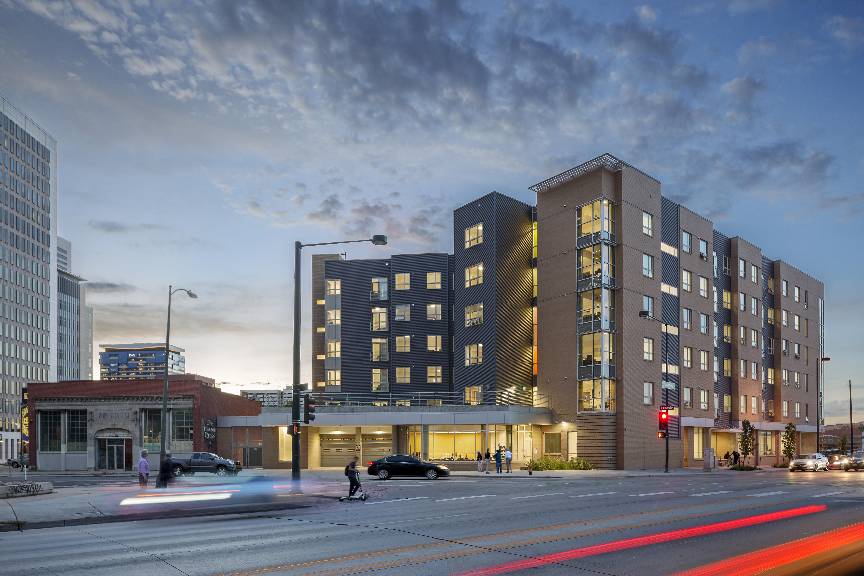
Property Management & Service Providers:
Dynamic Duos in Permanent Supportive Housing
Carrie Craig, MSW, LCSW, Director of Housing First and ACT Services

Slide 2
What is Permanent Supportive Housing?
HUD Definition:
Long-term, community-based housing that has supportive services for homeless persons with disabilities. This type of supportive housing enables special needs populations to live as independently as possible in a permanent setting.

Slide 3
Property Management and Supportive Services in PSH
Single Provider: One organization provides both property management and supportive services
Partnership: Two or more organizations work together to provide property management and supportive services

Slide 4
Colorado Coalition for the Homeless Housing First / Social Impact Bond Project
CCH: Non-profit organization providing housing, integrated healthcare, and supportive services to people currently or formerly experiencing homelessness.
Housing First Department: Consists of 5 modified Assertive Community Treatment teams including two Social Impact Bond teams.
Social Impact Bond (SIB) project: 5-year randomized control study focusing on high utilizers of jails and emergency services in Denver.
Renaissance Downtown Lofts (RDL): 101-unit apartment building with robust services available on-site for SIB project clients.
Notes:
CCH: Non-profit organization providing housing, integrated healthcare, and supportive services to people currently or formerly experiencing homelessness.
Housing First Department: Consists of 5 modified Assertive Community Treatment teams including two Social Impact Bond teams. Multi-disciplinary approach.
Social Impact Bond (SIB) project: 5-year randomized control study focusing on high utilizers of jails and emergency services (detox, ERs, etc.) in Denver.
Renaissance Downtown Lofts (RDL): 101-unit apartment building with robust services available on-site for SIB project clients.

Slide 5
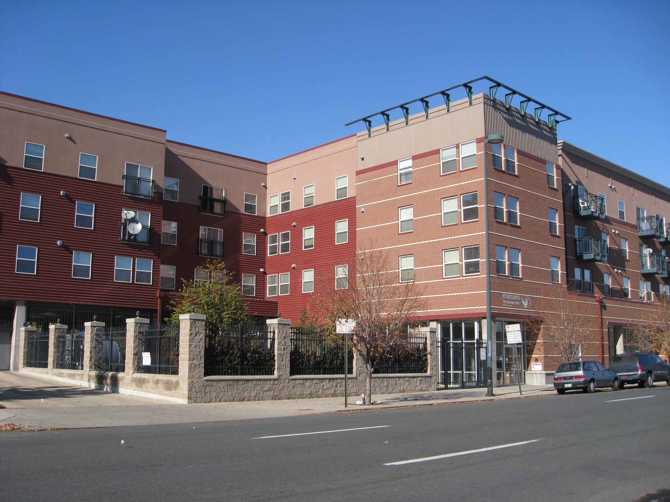
Renaissance Property Management Company
RPMC owns and operates 18 multifamily properties throughout Denver
1,703 units for families and individuals
Owned by CCH
Majority of the projects office the management team and some CCH service staff
RPMC represents the asset and CCH represents the services
Notes:
RPMC owns and operates 18 multifamily projects throughout Denver
1,703 units for families and individuals
Owned by CCH, thereby integrating housing and services
This provides necessary access and proximity to services and support
In this perspective, RPMC represents the asset and CCH represents the services

Slide 6
Dynamic Duos in PSH
Property Management Focus
RPMC and SIB/RDL Focus
Occupancy vs Income is a constant balancing act
Maintain the Asset
RPMC adheres to Fair Housing laws
Services and PM staff visited other PSH projects with integrated models
Resident Services Coordinator (RSC- hybrid position between two entities)
RSC role- liaison between PM and services, resources to residents, service planning and coordination
Advocacy for tenant will be planned, coordinated, and deliberate
ACT team housed in the building
Eviction Prevention efforts

Slide 7
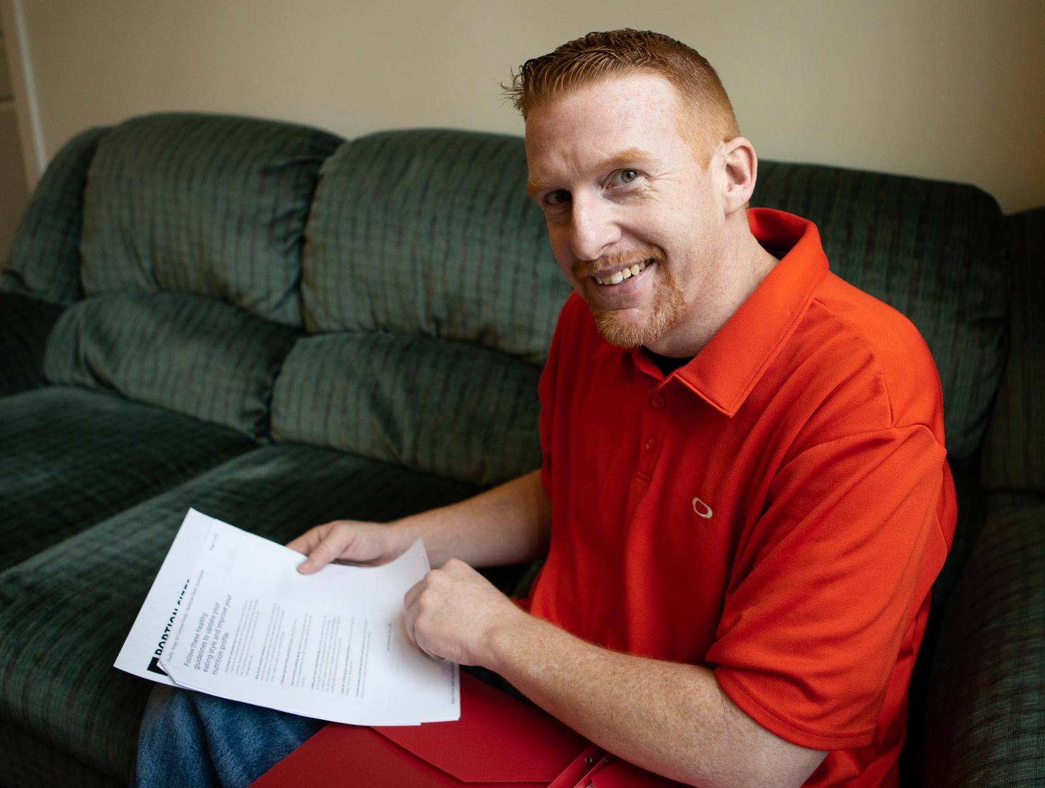
Resident/Client Orientation
Solicited client feedback from other newer properties
Services orientation and PM orientation (separated but integrated)
Ensuring residents know we are working together
Multiple education meetings prior to lease signing
SIB clients in one building- mass lease-ups
Robust service program on-site
Further education after move-in

Slide 8
Lease Signing and Community Policies
PM, housing team, and services staff meeting regularly to discuss lease terms and community policies
Reviewed community policies with clients PRIOR to lease-up day
Location of the building—need for increased security
Guest policies
Input from Resident Council and Town Hall meetings

Slide 9
Assimilation and Community Integration
Intensive services, especially for first 1-3 months
Life skills classes, BH groups/services, healthcare, peer outings, socialization events, etc.
Incentive Program
Resident Governance Council
Quarterly Town Hall meetings
Notes:
Intensive services especially for first 1-3 months- ACT model (home visits and community support)
Life skills classes, BH groups/services, healthcare, peer outings, socialization events, etc.
Incentive Program- “Good Neighbor” tokens
Resident Governance Council
Quarterly Town Hall meetings

Slide 10
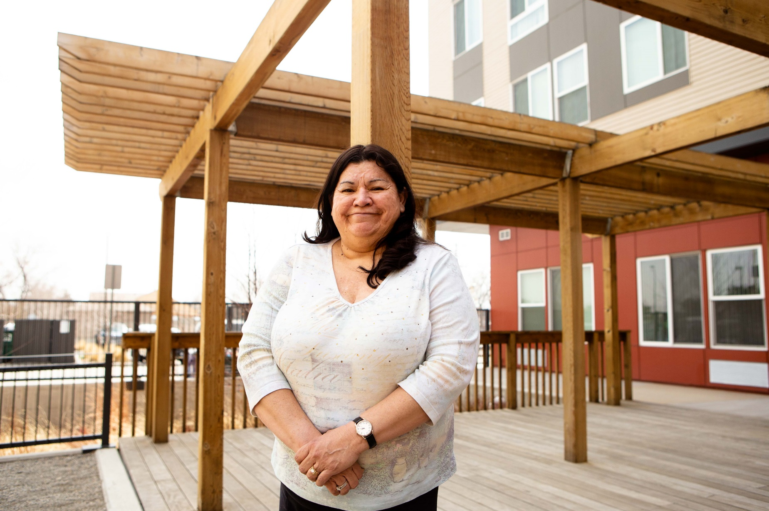
Stabilization and Housing Retention
Tenant conferences
Resident Governance Council and Town Hall meetings
Eviction Prevention Committee
Housing First model often 3-4 times housed before successful
RPMC and SIB staff working together to find other housing options at various other properties
Notes:
Tenant conferences- RPMC and service staff attending
Resident Governance Council and Town Hall meetings give input around services desired by the community
Eviction Prevention Committee
Housing First model often 3-4 times housed before successful
RPMC and SIB staff working together to find other housing options at various other properties (scattered site or property-based

Slide 11
Dynamic Duos in Eviction Prevention
Step 1: Eviction Prevention Subcommittee—identifying residents currently experiencing lease issues/violations
Step 2: Informal/preliminary intervention
Step 3: Tenant conference
Step 4: Eviction Prevention Subcommittee follow-up
Step 5: Full Eviction Prevention Committee—mutual lease rescission or notice to quit
Notes:
Step 1: Eviction Prevention Subcommittee (weekly meeting)- identifying residents currently experiencing lease issues/violations
Step 2: Informal/preliminary intervention (supportive service teams)
Step 3: Tenant conference (PM- “demand” phase)
Step 4: Eviction Prevention Subcommittee follow-up
Step 5: Full Eviction Prevention Committee (PM- “notice” phase)- mutual lease rescission or notice to quit

Slide 12
SIB Preliminary Results
Since February 2016, SIB Program housed 285 individuals experiencing homelessness
85% remain stably housed to date
Preliminary data on reduction in jail days is promising but results will not be fully released until the project’s end- 2020

Slide 13
Questions?

